Slide 1






Concordia, M.E., CIISE
Sentiment Analysis on Reddit Comments and Posts for OSINT Purposes
Rahul Ravi Hulli - 40234542
April 12, 2024

Slide 2
The Document Workflow
1
The Concept of Sentiment Analysis and Machine Learning
2
The Involvement of OSINT
3
LSTM and GRU Algorithm
4
Custom LSTM and GRU
5
The Methodology
6
Evaluation and Conclusion
7
Questions?
2
Sentiment Analysis on Reddit Comments and Posts for OSINT Purposes
April 12, 2024

Slide 3

1.
The Concept of Sentiment Analysis and Machine Learning
Sentiment analysis: NLP and ML assess text emotions, aiding in opinion and brand perception comprehension.
ML Algorithms: Trained on labeled data to classify sentiment.
Lexicon-based Methods: Assign sentiment scores to words and aggregate for overall sentiment.
Pre-built Tools: Provide user-friendly interfaces for quick analysis.
Hybrid Approaches: Combine methods for nuanced sentiment analysis.
3
Sentiment Analysis on Reddit Comments and Posts for OSINT Purposes
April 12, 2024
Notes:
Sentiment Analysis: Computers understand feelings in text using NLP and ML. Helps understand opinions and brand perception.
ML Algorithms: Computers learn from labeled data to guess if text is positive, negative, or neutral.
Lexicon-based Methods: Words get scores for positivity or negativity, added up for overall sentiment.
Pre-built Tools: Easy programs for quick sentiment analysis, no coding needed.
Hybrid Approaches: Mixing methods for detailed sentiment analysis.

Slide 4
2.
The Involvement of OSINT
Data Collection: OSINT gathers diverse data from social media, news, and reviews.
Data Processing: OSINT tools use NLP for large dataset analysis.
Sentiment Analysis: OSINT identifies sentiment (positive, negative, neutral) for insights.
Issue Detection: OSINT detects reputational risks by monitoring sentiment.
4
Sentiment Analysis on Reddit Comments and Posts for OSINT Purposes
April 12, 2024
Notes:
OSINT Involvement in Sentiment Analysis
Data Collection: OSINT gathers info from social media, news, and reviews.
Data Processing: OSINT tools use NLP to analyze big data sets.
Sentiment Analysis: OSINT spots feelings (positive, negative, neutral) for insights.
Issue Detection: OSINT finds reputation risks by tracking sentiment.

Slide 5
3.
LSTM and GRU Algorithm
LSTM and GRU are types of recurrent neural networks used for sequence modeling and prediction, with LSTM being known for its longer memory retention and GRU for its simpler architecture with fewer parameters.
5
Sentiment Analysis on Reddit Comments and Posts for OSINT Purposes
April 12, 2024
Notes:
LSTM and GRU Algorithms
LSTM: This is a type of neural network used for predicting sequences. It's good at remembering things for a long time.
GRU: Another type of neural network for sequence prediction. It's simpler and has fewer parts compared to LSTM.

Slide 6
LSTM and GRU Algorithm
Initialize cell state ct​ and hidden state ht​ Determine what information to keep or discard from the cell state using update and forget gates. Regulate the amount of new information to be added to the cell state with the input gate. Update the cell state based on the gates. Compute the hidden state based on the updated cell state.
Initialize the update gate zt​ and reset gate rt​. Control how much of the past hidden state to combine with the new candidate hidden state using the update gate. Determine how much of the past hidden state to forget with the reset gate. Compute the candidate hidden state. Update the current hidden state using the update gate and the candidate hidden state.
6
Sentiment Analysis on Reddit Comments and Posts for OSINT Purposes
April 12, 2024
Notes:
LSTM Algorithm Steps
Initialize States: Start with initial cell state (ct) and hidden state (ht).
Update and Forget Gates: Decide what to keep or forget from the cell state using update and forget gates.
Input Gate: Control how much new information to add to the cell state.
Update Cell State: Update the cell state based on the gates' decisions.
Compute Hidden State: Calculate the new hidden state based on the updated cell state.
GRU Algorithm Steps
Initialize Gates: Start by setting up the update gate (zt) and the reset gate (rt).
Update Gate (zt): Decide how much of the past hidden state to blend with the new candidate hidden state.
Reset Gate (rt): Determine how much of the past hidden state to forget.
Compute Candidate Hidden State: Calculate the new candidate hidden state.
Update Hidden State: Use the update gate and the candidate hidden state to update the current hidden state.

Slide 7
What more?
Text Vectorization
Text vectorization is the process of converting textual data into numerical vectors.
Character Embeddings: Like word embeddings, they represent words as vectors based on their constituent characters.
Embedding Layers over text
Used to convert high-dimensional categorical data, such as words or entities, into lower-dimensional dense vectors, known as embeddings
Notes:
Input: Words or entities are fed into the embedding layer.
Embedding Matrix: The layer stores a table where each word has a unique number, and each number corresponds to a set of numbers representing the word's meaning.
Lookup Operation: When a word is inputted, the layer quickly finds its corresponding set of numbers in the table.
Output: The layer returns the set of numbers, which represent the word's meaning and context in a more compact form.

Slide 8
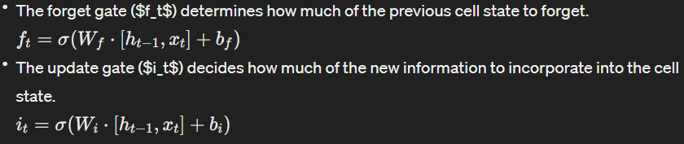
LSTM Algorithm Equations
Initialize States
Initial cell state ($c_0$) and hidden state ($h_0$) are typically set to zero vectors or small random values.
Update and Forget Gates:
Input Gate
Notes:
1. **Forget Gate ($f_t$)**:
- This gate helps the model decide what information from the previous cell state to forget or remember.
- Imagine you're deciding what memories are important to keep from the past. The forget gate helps in determining which memories are no longer relevant and can be forgotten.
2. **Update Cell State ($c_t$)**:
- Here, the model updates the cell state based on the decisions made by the forget gate, input gate, and the candidate cell state.
- It's like revising the rough draft of the cell state, taking into account what to forget from the past and what new information to add from the current input.
3. **Input Gate ($i_t$)**:
- This gate helps the model decide how much new information should be added to the cell state.
- It determines what new information is important to remember from the current input and should be added to the cell state.

Slide 9
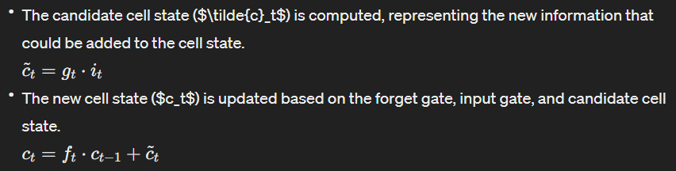
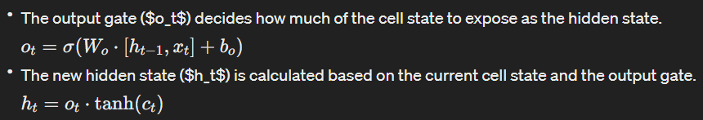
LSTM Algorithm Equations
Update Cell State
Compute Hidden State
Notes:
4. **Candidate Cell State ($\tilde{c}_t$)**:
- This represents the new information that could be added to the cell state.
- It's like a rough draft of the new cell state, based on the current input and previous cell state.
Output Gate ($o_t$):
This gate decides how much of the updated cell state should be exposed as the hidden state.
It determines what information is relevant to pass on to the output or next hidden state.
Hidden State ($h_t$):
The new hidden state is calculated based on the updated cell state and the output gate.
It represents the information that will be passed on to the next time step or used for the final prediction.

Slide 10
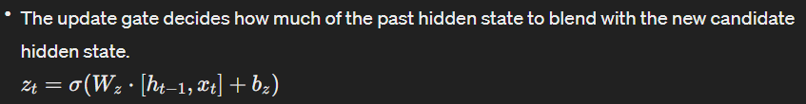
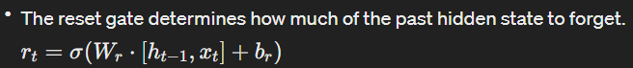
GRU Algorithm Equations
Initialize Gates
Start by initializing the update gate ($z_t$) and the reset gate ($r_t$).
Update Gate ($z_t$)
Reset Gate ($r_t$)
Notes:
Sure, let's simplify the equations for the Gated Recurrent Unit (GRU) algorithm:
1. **Update Gate ($z_t$)**:
- This gate decides how much of the previous hidden state should be mixed with the new candidate hidden state.
- Think of it as deciding how much of the old memory to keep compared to the new memory. If the gate is close to 1, it keeps most of the old memory; if it's close to 0, it mostly relies on the new memory.
2. **Reset Gate ($r_t$)**:
- The reset gate determines how much of the previous hidden state should be forgotten.
- It helps in deciding which parts of the old memory are still relevant. If the gate is close to 1, it keeps most of the old memory; if it's close to 0, it forgets most of it.

Slide 11
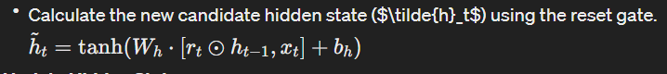
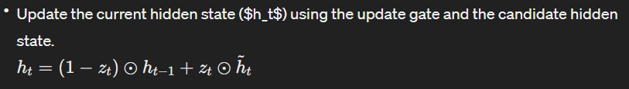
GRU Algorithm Equations
Compute Candidate Hidden State
Update Hidden State
Notes:
3. **Candidate Hidden State ($\tilde{h}_t$)**:
- This is like a new suggestion for the hidden state based on the current input and previous hidden state, considering the reset gate.
- It's a fresh idea of what the new hidden state could be, taking into account the current input and what parts of the old memory are still relevant.
4. **Hidden State Update ($h_t$)**:
- Here, we blend the previous hidden state with the candidate hidden state, using the update gate to control the blending.
- It's like mixing the old memory with the new suggestion, where the update gate decides how much of each to use. If the gate is close to 1, it mostly keeps the old memory; if it's close to 0, it mostly adopts the new suggestion.

Slide 12
4.
Custom LSTM and GRU
Understand core concepts: Grasp LSTM and GRU theoretical foundations, including gating mechanisms.
Leverage existing libraries: Utilize TensorFlow/Keras and Hugging Face Transformers.
Implement core layers: Develop LSTM and GRU layers with gates and state updates.
Integrate with workflows: Ensure seamless integration with sentiment analysis tasks.
7
Sentiment Analysis on Reddit Comments and Posts for OSINT Purposes
April 12, 2024
Notes:
Custom LSTM and GRU Algorithm Overview
Understanding Core Concepts: Gain insight into the theoretical foundations of LSTM and GRU, focusing on their gating mechanisms for memory management.
Leveraging Existing Libraries: Utilize TensorFlow/Keras and Hugging Face Transformers, popular frameworks for deep learning and natural language processing tasks.
Implementing Core Layers: Develop LSTM and GRU layers within these frameworks, incorporating gating mechanisms and state updates to handle sequential data effectively.
Integrating with Workflows: Ensure seamless integration of custom LSTM and GRU layers with sentiment analysis tasks, enabling efficient processing of text data to extract sentiment insights.

Slide 13
Custom LSTM
Algorithm 1 Custom LSTM: 1. Input: - units: number of units in the LSTM layer - return sequences: boolean indicating output for each time step or just final output 2. Initialize: - Inherit from tf.keras.layers.Layer - Store units and return sequences parameters 3. Define build method: - Get input shape and extract input dim - Initialize weights and biases for LSTM gates and components 4. Define call method: - Get batch size and time steps - Initialize hidden and cell states to zeros - Create empty list for outputs - Loop over time steps: - Compute forget gate, input gate, candidate cell state, update cell state, output gate, and update hidden state - Append hidden state to outputs list - If return sequences is True, stack outputs along time dimension and return sequence - If return sequences is False, return final hidden state
8
Sentiment Analysis on Reddit Comments and Posts for OSINT Purposes
April 12, 2024
Notes:
Custom LSTM Algorithm Overview
Input Parameters:
units: Number of units in the LSTM layer.
return_sequences: Boolean indicating whether to output for each time step or just the final output.
Initialization:
Create a custom LSTM layer by inheriting from tf.keras.layers.Layer.
Store parameters such as units and return_sequences.
Build Method:
Determine the input shape and extract the input dimension.
Initialize weights and biases for LSTM gates and components.
Call Method:
Get the batch size and number of time steps from the input data.
Initialize hidden and cell states to zeros.
Create an empty list to store outputs.
Iterate over time steps:
Compute the forget gate, input gate, candidate cell state, update cell state, output gate, and update hidden state.
Append the hidden state to the outputs list.
If return_sequences is True, stack outputs along the time dimension and return the sequence.
If return_sequences is False, return the final hidden state.

Slide 14
Custom GRU
Algorithm 2 Custom GRU: 1. Input: - units: number of units in the GRU layer - return sequences: boolean indicating output for each time step or just final output 2. Initialize: - Inherit from tf.keras.layers.Layer - Store units and return sequences parameters 3. Define build method: - Get input shape and extract input dim - Initialize weights and biases for GRU gates and components 4. Define call method: - Get batch size and time steps - Initialize hidden states to zeros - Create empty list for outputs - Loop over time steps: - Compute update gate, reset gate, candidate hidden state, update hidden state - Append hidden state to outputs list - If return sequences is True, stack outputs along time dimension and return sequence - If return sequences is False, return final hidden state
9
Sentiment Analysis on Reddit Comments and Posts for OSINT Purposes
April 12, 2024
Notes:
Custom GRU Algorithm Overview
Input Parameters:
units: Number of units in the GRU layer.
return_sequences: Boolean indicating whether to output for each time step or just the final output.
Initialization:
Create a custom GRU layer by inheriting from tf.keras.layers.Layer.
Store parameters such as units and return_sequences.
Build Method:
Determine the input shape and extract the input dimension.
Initialize weights and biases for GRU gates and components.
Call Method:
Get the batch size and number of time steps from the input data.
Initialize hidden states to zeros.
Create an empty list to store outputs.
Iterate over time steps:
Compute the update gate, reset gate, candidate hidden state, and update hidden state.
Append the hidden state to the outputs list.
If return_sequences is True, stack outputs along the time dimension and return the sequence.
If return_sequences is False, return the final hidden state.

Slide 15
5.
The Methodology
Utilized LSTM and GRU libraries for depression analysis on the dataset, computing accuracies, F1 scores, and other metrics.
Employed custom implementations of LSTM and GRU libraries to repeat the analysis, ensuring consistency in evaluation methods.
Conducted a thorough comparison between results obtained from the standard library implementations and the custom versions.
Examined the performance, accuracy, and efficiency of both standard and custom libraries in depression analysis tasks.
Presented findings to highlight any discrepancies or advantages between the standard and custom implementations, aiding in informed decision-making for future analyses.
10
Sentiment Analysis on Reddit Comments and Posts for OSINT Purposes
April 12, 2024
Notes:
Methodology Overview
Utilized Libraries: Used pre-existing LSTM and GRU libraries for analyzing depression data, calculating metrics like accuracy and F1 scores.
Custom Implementations: Developed our own LSTM and GRU algorithms for the same analysis to ensure consistency.
Thorough Comparison: Compared results from standard library implementations with our custom versions to evaluate performance.
Performance Evaluation: Examined accuracy and efficiency of both standard and custom libraries for depression analysis.
Presentation of Findings: Shared findings to highlight any differences or benefits between standard and custom implementations, aiding future analysis decisions.

Slide 16
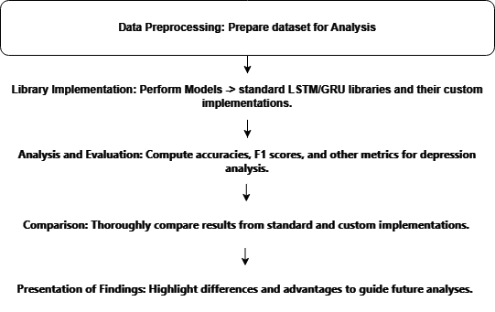
The Methodology
11
Sentiment Analysis on Reddit Comments and Posts for OSINT Purposes
April 12, 2024
Notes:
Data Preprocessing This preprocessing function aims to clean and prepare text data for analysis by removing irrelevant or redundant information. Here's a breakdown of the steps:
Convert to Lowercase: The text is converted to lowercase to ensure uniformity and consistency.
Remove Square Brackets and Contents: Any text within square brackets, typically used for citations or references, is removed.
Remove URLs: URLs, both HTTP and WWW, are removed from the text as they often contain irrelevant information for analysis.
Remove HTML Tags: Any HTML tags, such as <p> or <div>, are removed from the text.
Remove Punctuation: All punctuation marks are removed from the text using regular expressions.
Remove Newline Characters: Any newline characters, such as \n, are removed from the text.
Remove Alphanumeric Characters with Digits: Alphanumeric characters containing digits are removed from the text.
Apply Stemming: Porter Stemmer is used to reduce words to their root form, which helps in consolidating variations of words into their base form. This reduces the vocabulary size and helps in improving the performance of models by reducing sparsity.
Library Implementation
Analysis and Evaluation: Accuracy: Measures the proportion of correctly predicted instances out of the total instances. It's a general measure of model performance.
Weighted Average: Calculates the average of precision, recall, F1-score, and support, weighted by the number of instances for each class. It accounts for class imbalances.
Macro Average: Computes the unweighted average of precision, recall, F1-score, and support across all classes. Each class contributes equally to the average, regardless of its size.
Precision: Measures the proportion of true positive predictions out of all positive predictions made by the model.
Recall: Measures the proportion of true positive predictions out of all actual positive instances in the dataset.
F1-score: Harmonic mean of precision and recall. It balances between precision and recall, providing a single score that considers both.
Support: The number of actual occurrences of each class in the dataset. It helps in understanding the distribution of classes and can influence the interpretation of other metrics.
Plotting Model Accuracy & Loss:
- Visualize training and validation accuracy for LSTM, GRU, Custom LSTM, and Custom GRU models.
- Assess learning performance and detect overfitting/underfitting.
- Similarly, plot training and validation loss to monitor error between actual and predicted values.
- Lower loss values indicate better performance.
- Compare accuracies and losses across models to guide model selection and optimization. Box plot of model performance: The box plot of model performance compares the accuracy scores of five different models: Dense Model, LSTM Model, GRU Model, Custom LSTM Model, and Custom GRU Model.
Feature Distribution Plots: Since feature distribution plots depend on the specific features you're interested in, you need to specify which features you want to visualize.
Model performance metrics bar plot: The provided code snippet creates a bar plot to visualize the accuracy scores of different models. This visualization aids in comparing the performance of the models based on their accuracy.
Confusion Matrix: The confusion matrix provides a tabular representation of the true and predicted classifications by a machine learning model.

Slide 17

6.
Evaluation and Conclusion
12
Sentiment Analysis on Reddit Comments and Posts for OSINT Purposes
April 12, 2024

Slide 18
6.
Evaluation
1
Accuracy: LSTM library achieves 95%, followed by GRU library at 94%; Custom LSTM and Custom GRU both attain 93%.
2
Precision: LSTM library shows highest precision for class 0 (96%), followed by Custom LSTM (95%), while GRU library and Custom GRU exhibit 94% for class 0. For class 1, LSTM library and Custom LSTM achieve 94%, while GRU library and Custom GRU reach 93%.
3
Recall: LSTM library has highest recall for class 1 (96%), followed by Custom LSTM (95%), while GRU library and Custom GRU achieve 94% for class 1. For class 0, all models have similar recall scores ranging from 93% to 94%.
4
F1-score: LSTM library and Custom LSTM achieve highest F1-score for class 0 (95%), followed by GRU library and Custom GRU at 94%. For class 1, LSTM library and Custom LSTM achieve 95%, while GRU library and Custom GRU attain 94%.
5
Overall Performance: All models demonstrate strong performance with accuracy ranging from 93% to 95%.
6
Model Selection: LSTM library emerges as top-performing model with highest accuracy, precision, recall, and F1-score.
7
Consideration: Model selection should consider factors beyond performance metrics, such as computational resources and interpretability.
13
Sentiment Analysis on Reddit Comments and Posts for OSINT Purposes
April 12, 2024

Slide 19
6.
Evaluation
8
Metric Discrepancy: Custom implementations may show slightly lower precision, recall, and F1-score compared to library functions.
9
Accuracy Gap: Lower accuracy in custom implementations suggests more incorrect predictions overall.
10
Loss Variation: Higher training and validation loss in custom implementations imply less effective error minimization and poorer generalization.
11
Convergence Challenges: Custom implementations may exhibit slower convergence and less stable performance over epochs.
12
Optimization Deficiency: Lack of extensive optimization and fine-tuning may contribute to inferior performance in custom implementations.
13
Stopwords Removal and Overfitting: Eliminating stopwords during preprocessing can lead to overfitting, as the model may rely too heavily on specific patterns, compromising its ability to generalize.
14
Retaining Stopwords for Generalization: Preserving stopwords provides the model with a broader range of linguistic cues, aiding in better generalization and improved performance on validation or test datasets.
14
Sentiment Analysis on Reddit Comments and Posts for OSINT Purposes
April 12, 2024

Slide 20
6.
Conclusion
15
Model Performance: LSTM library outperforms others, achieving highest accuracy, precision, recall, and F1-score, indicating effective capture of data patterns.
16
Custom GRU Performance: Shows lowest overall performance with slightly lower metrics compared to other models.
17
Model Selection: LSTM library is preferred for maximizing predictive performance, but considerations like computational efficiency and interpretability should also be weighed.
18
Stopwords Removal: Decision to remove stopwords impacts model performance and generalization, potentially leading to overfitting.
19
Custom Implementation Variance: Differences in optimization techniques, model architectures, and training procedures contribute to performance discrepancies between custom implementations and library functions.
15
Sentiment Analysis on Reddit Comments and Posts for OSINT Purposes
April 12, 2024

Slide 21

5.
The Future Aspects
Project Uploaded on GitHub
The datasheet can be replaced with one with more classes
Better data collection for OSINT Analysis
16
Sentiment Analysis on Reddit Comments and Posts for OSINT Purposes
April 12, 2024

Slide 22
Questions?
17
Sentiment Analysis on Reddit Comments and Posts for OSINT Purposes
April 12, 2024

Slide 23
Thank you

